Slide 1
Background Elimination
Building 3D scenes from 2D images using ML algorithms
Jiahao Wang
Hongyi Rao
Yiqin Zhang

Slide 2
Final Goal
Develop a tool which can turn several 2d images of an object into a 3d model
Problem in Sprint 2
MVSNet cannot eliminate background disturbance effectively.
Solution
Eliminate background before reconstruct 3d models

Slide 3
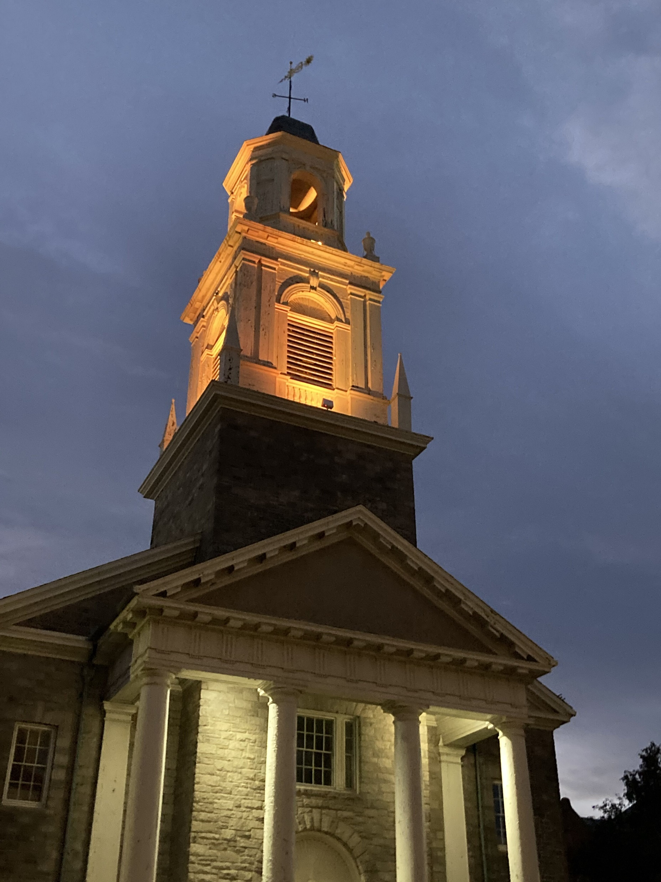
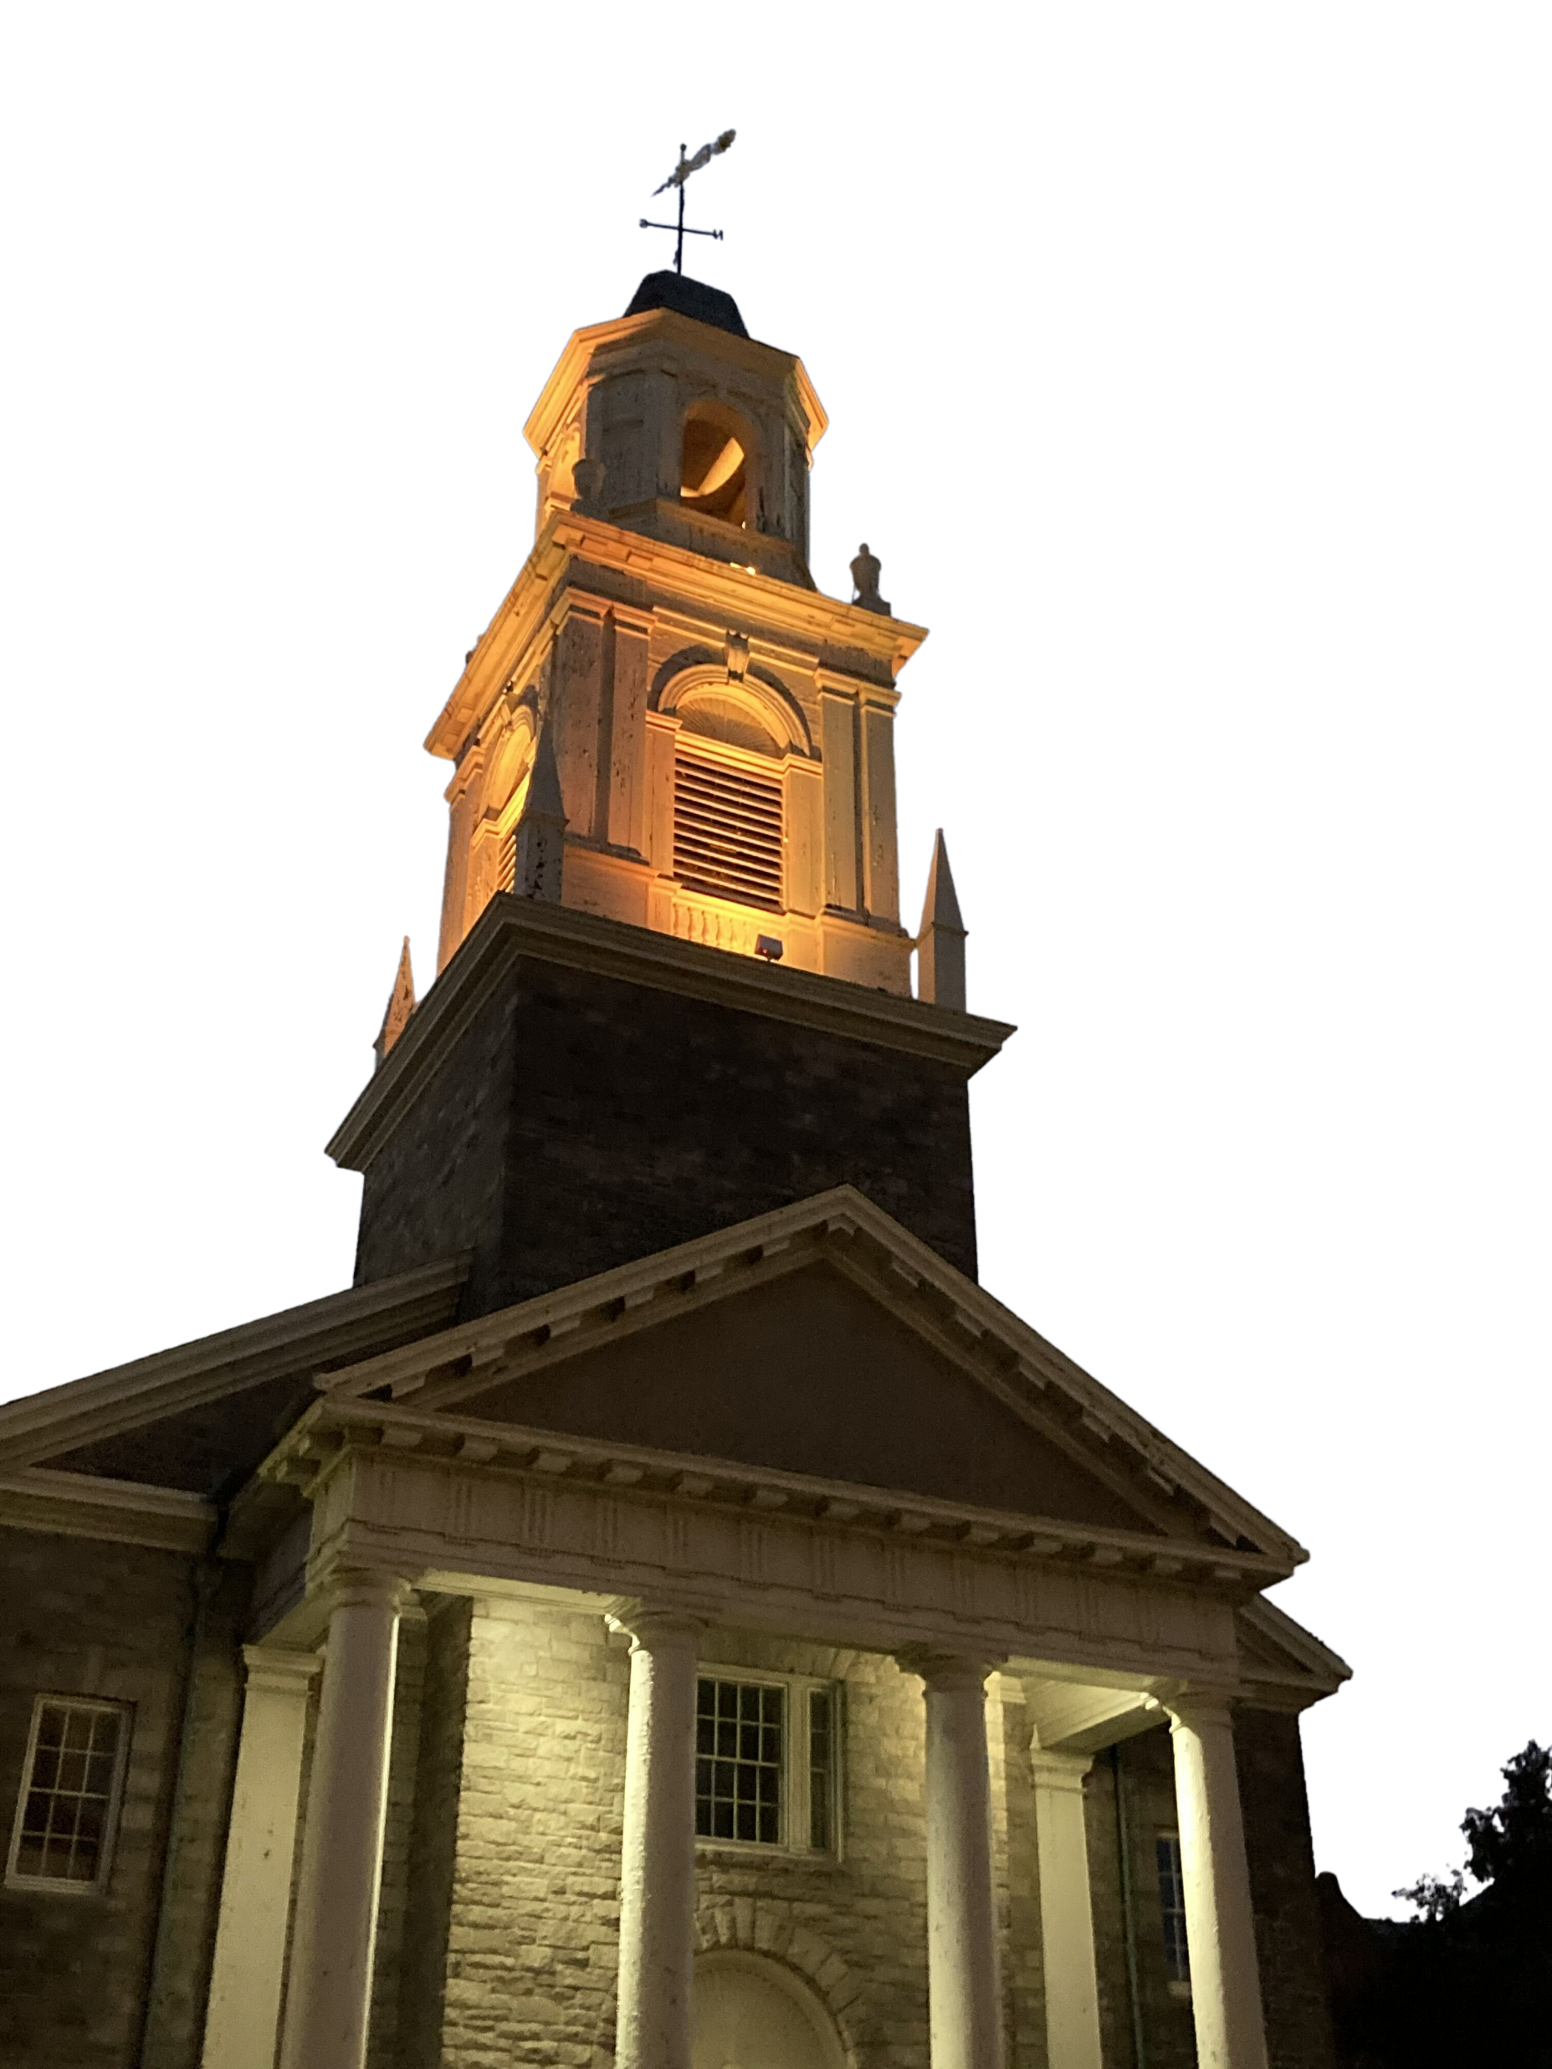
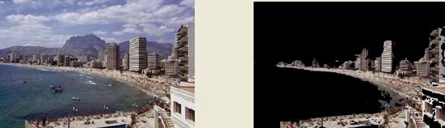
Performance
U. Erkut, F. Bostancıoğlu, M. Erten, A. M. Özbayoğlu and E. Solak, "HSV Color Histogram Based Image Retrieval with Background Elimination," 2019 1st International Informatics and Software Engineering Conference (UBMYK), 2019, pp. 1-5, doi: 10.1109/UBMYK48245.2019.8965513.
Remove.bg

Slide 4
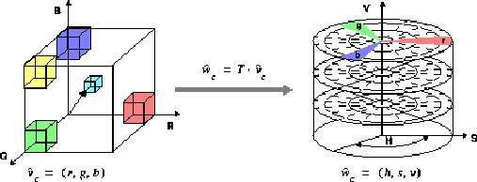
Method
HSV Color Histogram Based Image Retrieval
The Hue/Saturation/Value model was created by A. R. Smith [16] in 1978. It is based on such intuitive color characteristics as tint, shade and tone (or family, purity and intensity). The coordinate system is cylindrical, and the colors are defined inside a hexcone. The hue value H runs from 0 to 360°. The saturation S is the degree of strength or purity and is from 0 to 1. Purity is how much white is added to the color, so S=1 makes the purest color (no white). Brightness V also ranges from 0 to 1, where 0 is the black.
This algorithm uses the H-component of the HSV histogram and goes through the histogram to find peaks that indicate dominant colors throughout the image. When the peak is detected, a threshold level is set depending on the peak value, a typical value is %10 of the peak value. The cutoff colors from both sides of the peak are detected by extending to both sides until the histogram value goes below the threshold level. Also another criteria depends on the histogram integral within the chosen interval which must be above a specified threshold to be qualified as a peak. The selected peaks and their cutoff colors are ordered according to their histogram integrals from highest to lowest. As a result, the first peak provided by the algorithm is assumed to belong to the background, since it has the most dominant colors of the image. To retrieve only the foreground information, background is eliminated from the image from the cutoff points. If other peaks are detected by the algorithm, not only the background is eliminated, but any colors that remain outside the non-dominant peaks are also eliminated.
They have used an image database of 1000 images with different characteristics and obtained their color histograms in the HSV color space. The software also allowed the user to select the number of images to be searched and display the retrieved images sorted in the descending order of similarity.

Slide 5
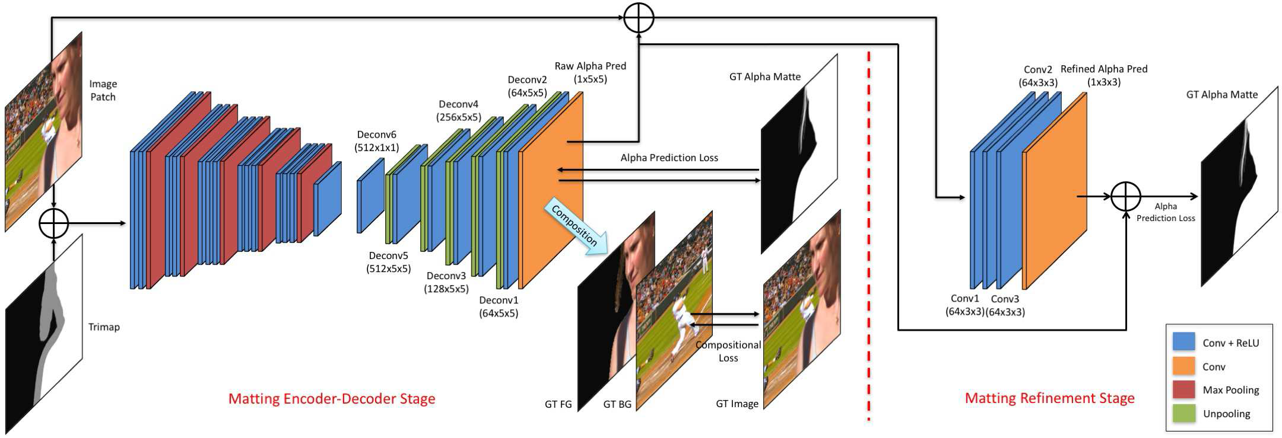
Method
Deep Learning
They address the image matting problem using deep learning. Given their new dataset, they train a neural network to fully utilize the data. The network consists of two stages . The first stage is a deep convolutional encoder-decoder network which takes an image patch and a trimap as input and is penalized by the alpha prediction loss and a novel compositional loss. The second stage is a small fully convolutional network which refines the alpha prediction from the first network with more accurate alpha values and sharper edges.
Ning Xu, Brian Price, Scott Cohen, Thomas Huang; Proceedings of the IEEE Conference on Computer Vision and Pattern Recognition (CVPR), 2017, pp. 2970-2979

Slide 6
Sprint 4 Plan
Combine background elimination algorithms with 3d reconstruction algorithms and test them

